Slide 1
HEAT TREATMENT OF METALS
Annealing
Martensite Formation in Steel
Precipitation Hardening
Surface Hardening
Heat Treatment Methods and Facilities

Slide 2
Heat Treatment
Various heating and cooling procedures performed to effect structural changes in a material, which in turn affect its mechanical properties
Most common applications are on metals
Similar treatments are performed on
  - Glass-ceramics
  - Tempered glass
  - Powder metals and ceramics

Slide 3
Heat Treatment in the Manufacturing Sequence
Heat treatment operations on a metallic work-part can be performed at various times during its manufacturing sequence
  In some cases, heat treatment is applied prior to shaping; for example, to soften a metal for forming
  In other cases, heat treatment is used to relieve strain hardening that occurs during forming
  And finally, heat treatment can be accomplished at or near the end of the sequence to achieve final strength and hardness

Slide 4
Principal Heat Treatments
Annealing (for ferrous and non-ferrous alloys)
Martensite formation in steel (for ferrous alloys)
Tempering of martensite (for ferrous alloys)
Precipitation hardening (for non-ferrous alloys e.g. Al alloys)
Surface hardening (mostly for ferrous alloys)

Slide 5
Annealing
Heating the metal to a suitable temperature, soaking at that temperature for a certain time, and slowly cooling
Reasons to use annealing:
Reduce hardness and brittleness
Alter microstructure to obtain desirable mechanical properties
Soften metals to improve machinability or formability
Recrystallize cold worked (strain-hardened) metals
Relieve residual stresses induced by prior shaping

Slide 6
Annealing of Steel
Full annealing (usually associated with low and medium carbon steels) - heating the alloy into the austenite region, followed by slow cooling to produce coarse pearlite
Normalizing - similar heating and soaking cycles, but cooling rates are faster, which results in fine pearlite, higher strength and hardness, but lower ductility than the full anneal treatment

Slide 7
Annealing to Reduce or Eliminate
Strain Hardening
Cold worked parts are often annealed to reduce strain hardening and increase ductility by allowing strain-hardened metal to recrystallize partially or completely
  - When annealing is performed to allow for further cold working of the part, it is called a process anneal
  - When no subsequent deformation will be accomplished, it is simply called an anneal

Slide 8
Annealing for Stress-Relief
Annealing operations are sometimes performed solely to relieve residual stresses caused by prior shape processing or fusion welding
  - Called stress-relief annealing
  - They help to reduce distortion and dimensional variations that might otherwise result in the stressed parts

Slide 9
Martensite Formation in Steel
The iron-carbon phase diagram shows the phases of iron and iron carbide under equilibrium conditions
  It assumes that cooling from high temperature has been slow enough to permit austenite to transform into a mixture of ferrite and cementite (Fe₃C)
However, under rapid cooling, so that equilibrium is prevented, austenite transforms into a nonequilibrium phase called martensite, which is hard and brittle

Slide 10
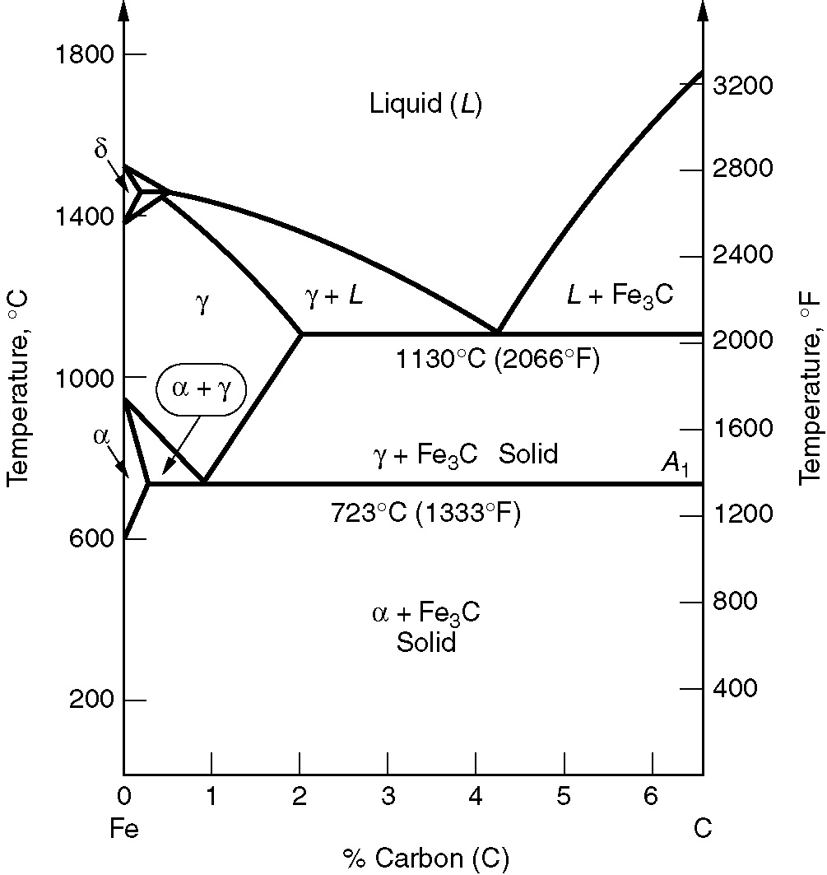

Slide 11
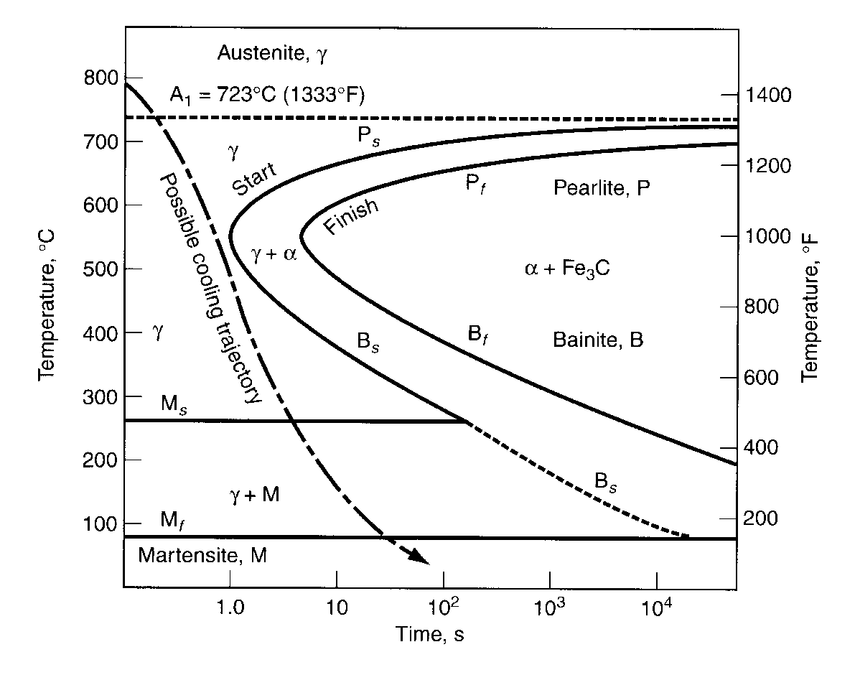
This slide is circulated only for information. Topic highlighted in this slide is beyond the scope of the present course.
Time-Temperature-Transformation Curve
The TTT curve, showing transformation of austenite into other phases as function of time and temperature for a composition of about 0.80% C steel. Cooling trajectory shown yields martensite

Slide 12
Martensite
A unique phase consisting of an iron‑carbon solution whose composition is the same as the austenite from which it was derived
Face-centered cubic (FCC) structure of austenite is transformed into body-centered tetragonal (BCT) structure of martensite almost instantly
The extreme hardness of martensite results from the lattice strain created by carbon atoms trapped in the BCT structure, thus providing a barrier to slip

Slide 13
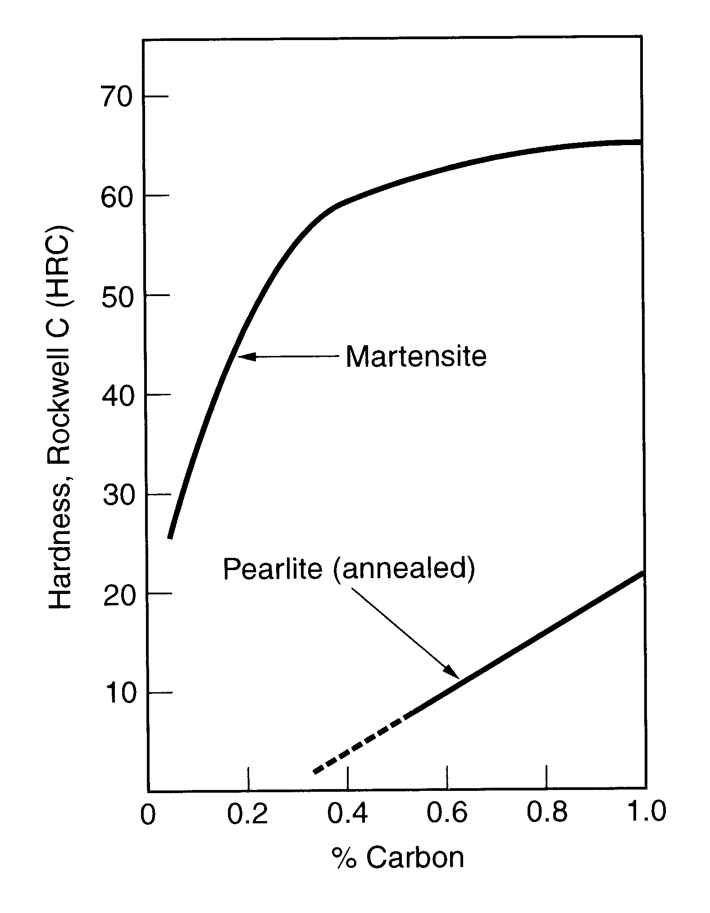
Hardness of plain carbon steel as a function of carbon content in martensite and pearlite (annealed)

Slide 14
Heat Treatment of Steel to Form Martensite
Consists of two steps:
Austenitizing - heating the steel to a sufficiently high temperature for a long enough time to convert it entirely or partially to austenite
Quenching - cooling the austenite rapidly enough to avoid passing through the nose of the TTT curve

Slide 15
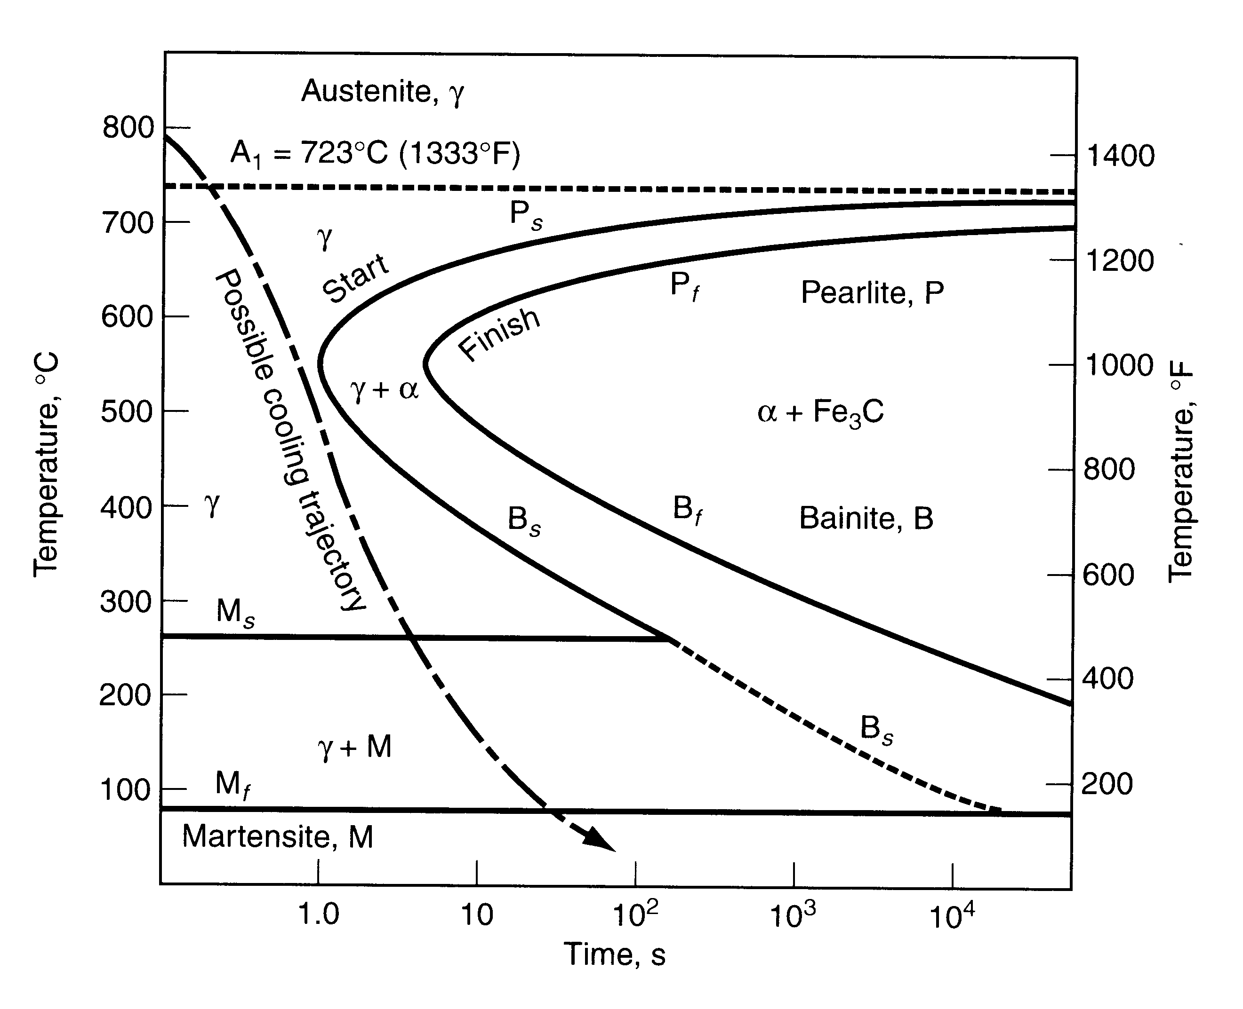
This slide is circulated only for information. Topic highlighted in this slide is beyond the scope of the present course.

Slide 16
Quenching Media and Cooling Rate
Various quenching media are used in commercial heat treatment operations to affect cooling rate
  - Brine (salt water, usually agitated)
  - Still fresh water
  - Still oil
  - Air
Quenching in agitated brine provides the fastest cooling rate, while air quench is the slowest
  - The faster the cooling, the more likely are internal stresses, distortion, and cracks in the product

Slide 17
Tempering of Martensite
A heat treatment applied to martensite to reduce brittleness, increase toughness, and relieve stresses
The treatment involves heating and soaking at a temperature below the eutectoid for approximately one hour, followed by slow cooling
Results in precipitation of very fine carbide particles from the martensite iron-carbon solution, gradually transforming the crystal structure from BCT to BCC
The new structure is called tempered martensite

Slide 18
Precipitation Hardening
Heat treatment that involves formation of fine particles (precipitates) that act to block the movement of dislocations and thus strengthen and harden the metal
Principal heat treatment for strengthening alloys of aluminum, copper, magnesium, nickel, and other nonferrous metals
Also utilized to strengthen a number of steel alloys that cannot form martensite by the usual method

Slide 19
Necessary Conditions for
Precipitation Hardening
The necessary condition for whether an alloy system can be strengthened by precipitation hardening is the presence of sloping solvus line in the phase diagram
A composition in this system that can be precipitation hardened is one that contains two equilibrium phases at room temperature, but which can be heated to a temperature that dissolves the second phase

Slide 20
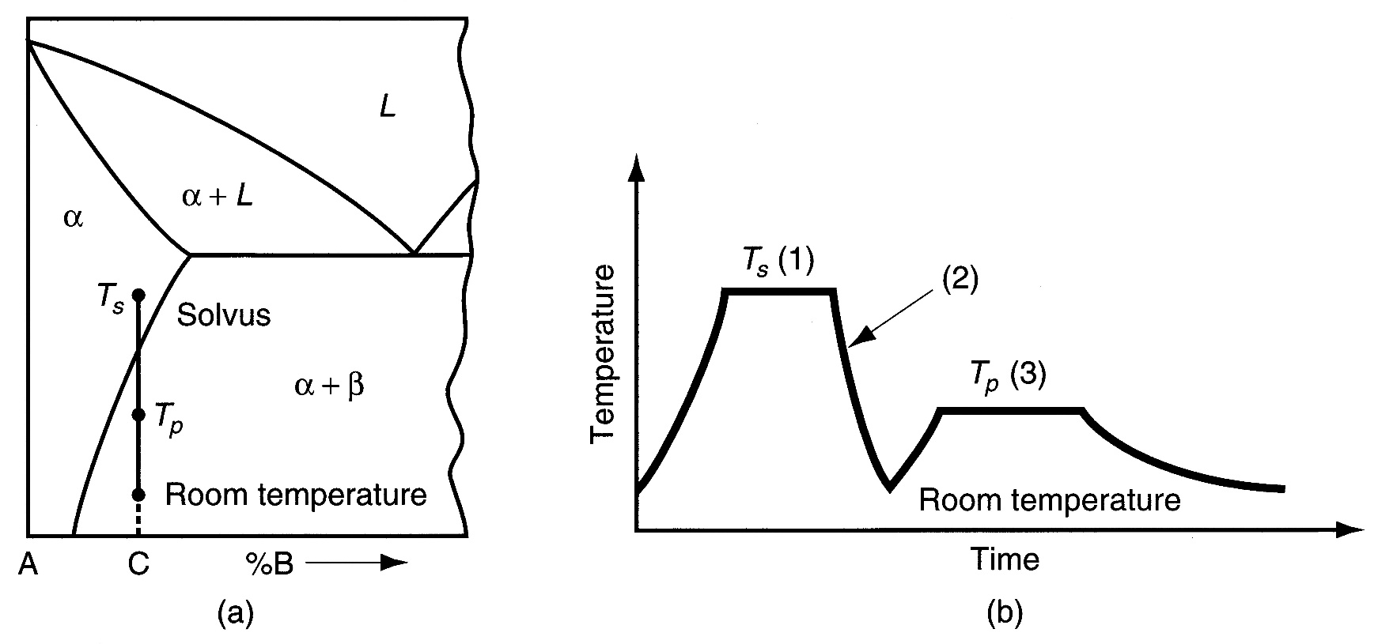
Precipitation Hardening:
phase diagram of an alloy system consisting of metals A and B that can be precipitation hardened;
heat treatment stages that include Solution-Treatment (1), Quenching (2), and Precipitation Hardening (3)

Slide 21
Heat Treatment Sequence in
Precipitation Hardening
Solution treatment - alloy is heated to a temperature T_{s} above the solvus line into the alpha phase region and held for a period sufficient to dissolve the beta phase
Quenching - to room temperature to create a supersaturated solid solution
Precipitation treatment - alloy is heated to a temperature T_{p}, below T_{s}, to cause precipitation of fine particles of the beta phase

Slide 22
Surface Hardening
Any of several thermochemical treatments applied to steels in which the composition of the part surface is altered by addition of various elements
Often called case hardening
Most common treatments are carburizing, nitriding, and carbonitriding
Commonly applied to low carbon steel parts to achieve a hard, wear‑resistant outer shell while retaining a tough inner core

Slide 23
Carburizing
Heating a part of low carbon steel in a carbon rich environment so that C is diffused into the surface
In effect the surface is converted to a high carbon steel, capable of higher hardness than the low C core
  Carburizing followed by quenching produces a case hardness of around HRC = 60
  Because internal regions consist of low C steel, whose hardenability is low, it is unaffected by the quench and remains relatively tough and ductile
Most common surface hardening treatment

Slide 24
Nitriding
Treatment in which nitrogen is diffused into surface of special alloy steels to produce a thin hard casing without quenching
Carried out at around 500°C (950°F)
To be most effective, the steel must contain alloying ingredients such as aluminum or chromium to form nitride compounds that precipitate as very fine particles in the casing to harden the steel
Hardness up to HRC 70

Slide 25
Chromizing
Requires higher temperatures and longer treatment times than the preceding hardening treatments
Usually applied to low carbon steels
Casing is not only hard and wear resistant; it is also heat and corrosion resistant

Slide 26
Selective Surface Hardening Methods
These methods heat only the work surface, or local areas of the work surface
They differ from surface hardening methods in that no chemical changes occur
Methods include:
  Flame hardening
  Induction hardening
  High-frequency resistance heating
  Electron beam heating
  Laser beam heating

Slide 27
Flame Hardening
Heating of work surface by one or more torches followed by rapid quenching
Applied to carbon and alloy steels, tool steels, and cast irons
Fuels include acetylene (C₂H₂), propane (C₃H₈), and other gases
Lends itself to high production as well as big components such as large gears that exceed the size capacity of furnaces

Slide 28
Induction Heating
Application of electromagnetically induced energy supplied by an induction coil to an electrically conductive workpart
Widely used for brazing, soldering, adhesive curing, and various heat treatments
When used for steel hardening treatments, quenching follows heating
Cycle times are short, so process lends itself to high production

Slide 29
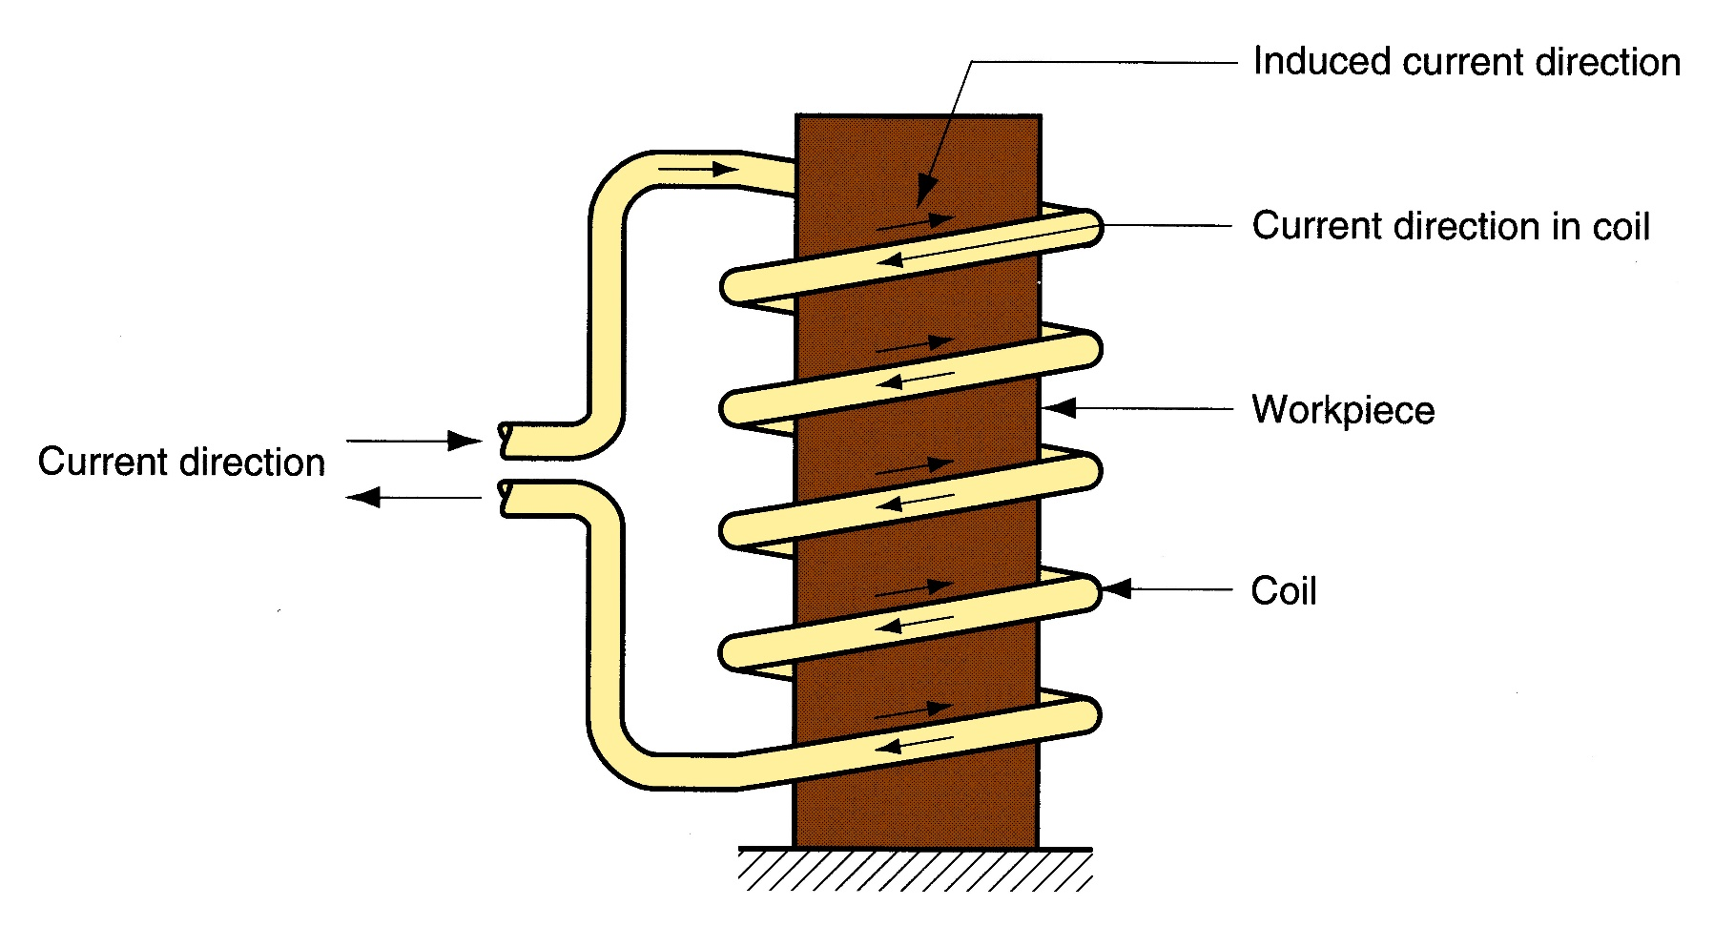
Typical induction heating setup. High frequency alternating current in a coil induces current in the workpart to effect heating

Slide 30
High-frequency (HF) Resistance Heating
Used to harden specific areas of steel work surfaces by application of localized resistance heating at high frequency (400 kHz typical)
Contacts are attached to workpart at the outer edges of the area
When HF current is applied, region under conductor is heated quickly to high temperature heating to austenite range typically takes less than a second
When power is turned off, area is quenched by heat transfer to the surrounding metal

Slide 31
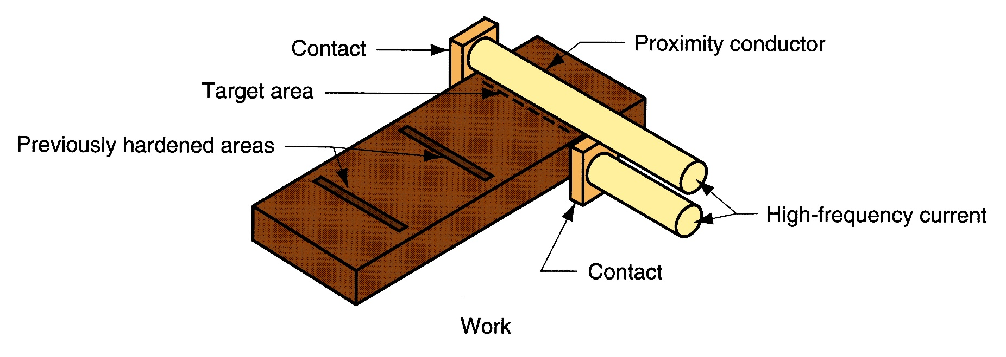
Typical setup for high-frequency resistance heating

Slide 32
Electron Beam (EB) Heating
Electron beam focused onto a small area, resulting in rapid heat buildup
Involves localized surface hardening of steel - high energy densities in a small region of the part so that austenitizing temperatures can be achieved often in less than a second
When beam is removed, heated area is immediately quenched and hardened by heat transfer to surrounding metal
Disadvantage: best results are achieved when performed in a vacuum, so production rates are slow

Slide 33
Laser Beam (LB) Heating
High-density beam of coherent light is focused on a small area the beam is usually moved along a defined path on the work surface
Laser - acronym for light amplification by stimulated emission of radiation
When beam is moved, area is immediately quenched by heat conduction to surrounding metal
Advantage of LB over EB heating is that laser beams do not require a vacuum to achieve best results

